Slide 1
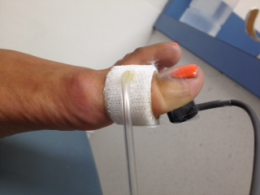
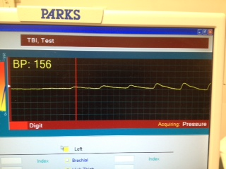
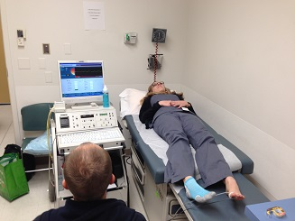
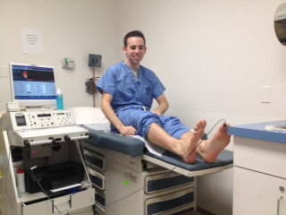
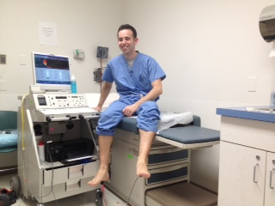
The Effect of Patient Positioning on Absolute Digital Toe Pressures with Non-Invasive Vascular Testing Laura Sansosti, DPMª, Michael D. Berger^{b}, Michael A. Gerrity^{b}, and Andrew J. Meyr, DPM^{c} ªResident, Temple University Hospital Podiatric Surgical Residency Program, Philadelphia, Pennsylvania ^{b}Student, Temple University School of Podiatric Medicine, Philadelphia, Pennsylvania ^{c}Associate Professor, Temple University School of Podiatric Medicine, Philadelphia, Pennsylvania
Statement of Purpose and Literature Review
Methods
Results
The primary non-invasive test utilized for the assessment of peripheral arterial disease (PAD) is the ankle brachial index (ABI). Unfortunately, the ABI may be relatively unreliable in patients with certain co-morbidities including diabetes [1-5]. This is attributable to medial arterial calcific sclerosis, which has the potential to lead to incompressibility of the arteries and falsely elevated non-invasive vascular testing results. However, studies have also demonstrated that the digital arteries of the toes are less prone to this type of medial calcification, and absolute digital pressures without ratios may give more reliable results with less false elevation. In fact, an often cited study reported healing in 85% of patients with an absolute toe pressure greater than 45mmHg, while healing occurred in only 36% of patients with digital pressures less than 45mmHg [1]. Based in part on these results, this is the primary diagnostic test and value utilized by the Temple University Hospital Limb Salvage Center in order to assess for healing potential of partial foot amputations and other interventions.
Current recommendations are for patients to undergo segmental Doppler examinations and pulse volume recordings in the supine position with the legs at heart level to minimize the effect of hydrostatic pressure. However, this positioning may be difficult in many limb salvage patients, particularly those that are non-ambulatory and those with painful chronic wounds. In these situations, the non-invasive vascular tests are often performed with the patient in a more comfortable position, which may include sitting in a wheelchair with the leg in a dependent position.
The objective of this investigation was to evaluate the effect of patient positioning on measurement of the absolute digital pressure.
The standard non-invasive vascular testing protocol utilized by the Temple University Hospital Limb Salvage Center was performed on 10 healthy and asymptomatic volunteers (5 male). Subjects removed their socks and shoes for approximately 10 minutes prior to testing in order to acclimate to the temperature of the room, and a segmental Doppler pulse volume recording was performed at hallux level on each subject (FLO-LAB 2100, Parks Medical Equipment, Las Vegas, NV, USA) (Figure 1).
Five serial measurements of each volunteer were obtained under three variable testing conditions (Figure 2): (1) while lying supine with the limbs at heart level [the recommended position for performance of the test], (2) while sitting upright with the limbs level on the table, and (3) while sitting upright with the limbs hanging in a dependent position.
The primary outcome measure of this investigation was mean digital pressure, and the variable was patient positioning. Data was collected and stored on a personal computer for subsequent analysis. All statistical analyses were performed using SAS®, version 9.2 (SAS Institute, Cary, NC). Descriptive statistics were reported in terms of the mean, standard deviation, standard error of the mean, and 95% confidence intervals (CI). Comparative statistics were performed with the paired student t-test to the control, which we defined as the volunteer in the supine position with the limbs at the level of the heart. A level of statistical significance was set at p = 0.05.
Results are displayed in Table 1. In terms of the primary outcome measure, the mean digital pressure ± standard deviation for subjects while lying supine with the limbs at heart level was 111.06 ± 29.15mmHg. The mean digital pressure for subjects while sitting upright with the limbs level on the table was 134.88 ± 31.65mmHg. The mean digital pressure for subjects while sitting upright with the limbs in a dependent position was 171.13 ± 28.95mmHg.
Mean digital pressures increased 21.45% as subjects moved from a position of lying supine with the limbs at heart level to sitting upright with the limbs level on the table, and this difference was statistically significant (111.06mmHg vs. 134.88mmHg; p<0.0001). Mean digital pressure increased 54.09% as subjects moved from a position of lying supine with the limbs at heart level to sitting upright with the limbs in a dependent position, and this difference was statistically significant (111.06mmHg vs. 171.13mmHg; p<0.0001). Mean digital pressure increased 26.88% as subjects moved from a position of sitting upright with the limbs level on the table to sitting upright with the limbs in a dependent position, and this difference was statistically significant (134.88mmHg vs. 171.13mmHg; p<0.0001).
Table 1: Descriptive and comparative statistical analysis of the primary outcome measure
Volunteer Positioning | Mean ± STD (mmHg) | Comparative Analysis (paired student t-test)
Lying supine with the limbs at heart level | 111.06±29.15 | Control
Sitting upright with the limbs level on the table | 134.88±31.65 | Vs. Control: +21.45%* (p<0.0001)
Sitting upright with the limbs in a dependent position | 171.13±28.95 | Vs. Control: +54.09%* (p<0.0001) Vs. Upright: +26.88%* (p<0.0001)
Figure 1: Measurement of the Primary Outcome Measure (Absolute Digital Pressure)
Figure 2: Measurement of the investigation variables (Volunteer positioning)
The primary outcome measure of this investigation was absolute digital pressure measured with the cuff and sensor at hallux level (left figure). On the right, one can appreciate objective measurement of the absolute pressure with visualization of the waveform.
The variable of this investigation was patient positioning. Our control position was the volunteer lying supine with the limbs at heart level (the recommended position for performance of the test), and serial measurements were also performed while sitting upright with the limbs level on the table and while sitting upright with the limbs hanging in a dependent position.
Conclusion
-We think that the results of this investigation demonstrate both statistically and clinically significant findings. We conclude that patient positioning has a significant effect on measurement of the absolute toe pressure. Mean recordings of absolute digital pressure increased by a statistically significant 54.09% as the limb moved into an increasingly dependent position. Based on these results, we recommend that diabetic limb surgeons discuss with their vascular technicians these potential positioning effects, and have them clearly document when pressure recordings are unable to be performed in the recommended supine position. This certainly appears to have the potential to affect interpretation of this test and assessment of healing potential in patients with ambulatory dysfunction.
-In conclusion, we hope that the results of this investigation increase the body of knowledge of foot and ankle surgeons with respect to both the performance and interpretation of non-invasive vascular testing.
References
[1] Apelqvist J, Castenfors J, Larsson J, Stenström A, Agardh CD. Prognostic value of systolic ankle and toe blood pressure levels in outcome of diabetic foot ulcer. Diabetes Care. 1989;12(6):373-8.
[2] Widmer LW, Vikatmaa P, Aho P, Lepäntalo M, Venermo M. Reliability and repeatability of toe pressures measured with laser Doppler and portable and stationary photoplethysmography devices. Ann Vasc Surg. 2012;26(3):404-10.
[3] Romanos MT, Raspovic A, Perrin BM. The reliability of toe systolic pressure and the toe brachial index in patients with diabetes. J Foot Ankle Res. 2010;3:31.
[4] Kröger K, Stewen C, Santosa F, Rudofsky G. Toe pressure measurements compared to ankle artery pressure measurements. Angiology. 2003;54(1):39-44.
[5] Park SC, Choi CY, Ha YI, Yang HE. Utility of Toe-brachial Index for Diagnosis of Peripheral Artery Disease. Arch Plast Surg. 2012;39(3):227-31.

